Slide 1
Software Versionierung
Warum .git?
Notes:
Welcome!

Slide 2
Github.com
Legt Euch bitte einen github.com account an.

Slide 3
.git Geschichte
Als open Source Ersatz für das proprietäre Versionierungstool “BitKeeper” von der Linux Kernel Community entwickelt.
Notes:
Subjects today, starting with why ownCloud exists and then talking about what it is and offers.

Slide 4
Herausforderungen der Software Entwicklung.
Sehr viele entwickler arbeiten zur selben Zeit am selben Code
Man braucht ein tool um “guten” von “schlechtem” Code zu trennen.
Jeder Entwickler möchte seine eigene Umgebung nutzen.
Teile des Codes müssen getestet werden, bevor sie dem Quellcode hinzugefügt werden.
Notes:
Who gets hurt when privacy is under attack?
Not government
Not defense contractors, oil companies
Not big arms and drugs traffickers
Not well funded terrorists
Nor politicians or rich people
They all have the means to protect their 'privacy' and harm yours.
A journalist or cop digging in a powerful gang?
A grass-roots group annoying incumbent politicians?
Local charity getting in the way of a company?
A small competitor out-innovating you?
All easy to deal with if you have all their data.

Slide 5
Was macht .git eigentlich?
.git verwaltet einen Baum von Dateien der über die Zeit wächst.
.git unterstützt die verteilte Software Entwicklung mit einem hohen Grad an Sicherheit, Flexibilität und Geschwindigkeit.
Neuer Code kann mit wenig Aufwand getestet werden.
Notes:
Aside from having many users, ownCloud also has a large development community.
In part that is because ownCloud is more than sync and share. Our apps bring functionality like calendar and contacts, mail, notes and much more to ownCloud.

Slide 6
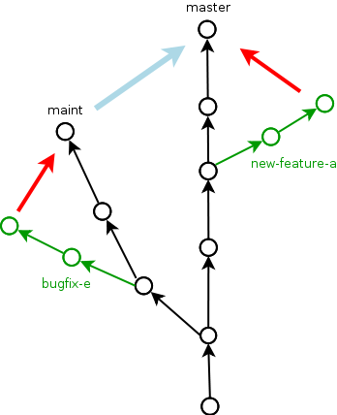
Übersicht
Notes:
Aside from having many users, ownCloud also has a large development community.
In part that is because ownCloud is more than sync and share. Our apps bring functionality like calendar and contacts, mail, notes and much more to ownCloud.

Slide 7
Wie funktioniert .git?
Mehrere Protokolle möglich: ssh, http, .git und commit per email.
Jeder Entwickler hat den kompletten Code des Repositorys auf seine Festplatte geklont.
Jede Datenänderung bzw. Jedes Hinzufügen von Daten erhält eine UID und ist somit zurückverfolgbar bzw. Wiederherstellbar.
Notes:
Aside from having many users, ownCloud also has a large development community.
In part that is because ownCloud is more than sync and share. Our apps bring functionality like calendar and contacts, mail, notes and much more to ownCloud.

Slide 8
Wieso sollte ich .git lernen?
Viele Unternehmen verwenden .git, z.B. die NASA oder SAP
In der OpenSource Entwicklung das Tool der Zeit: (LinuxKernel, Erlang, Joomla, Jquery, PHP, Zend Framework, Node.js…… werden alle mit .git verwaltet.
Google und Facebook setzen Headhunter auf Programmierer an die viel und guten Code schreiben.
Notes:
Aside from having many users, ownCloud also has a large development community.
In part that is because ownCloud is more than sync and share. Our apps bring functionality like calendar and contacts, mail, notes and much more to ownCloud.

Slide 9
Wieso sollte ich .git lernen?
Jeder kann einen .git Server betreiben,
(Gitlab,gitolite….etc.)
Schöne kleine Virtualisierung unter
https://hub.docker.com/r/gitlab/gitlab-ce/
Notes:
Aside from having many users, ownCloud also has a large development community.
In part that is because ownCloud is more than sync and share. Our apps bring functionality like calendar and contacts, mail, notes and much more to ownCloud.

Slide 10
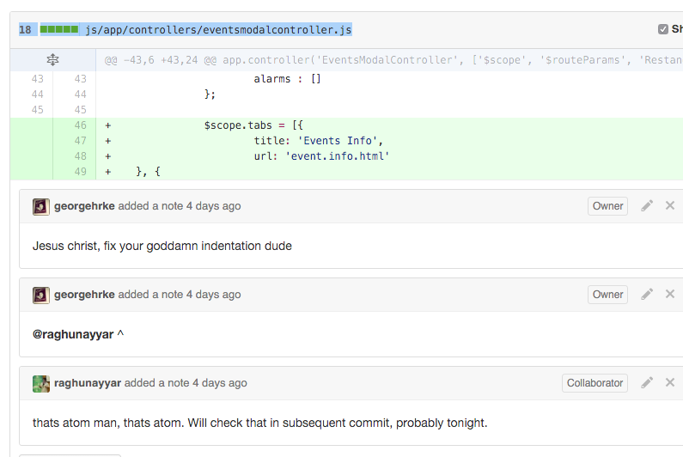
Beispiele
Notes:
Aside from having many users, ownCloud also has a large development community.
In part that is because ownCloud is more than sync and share. Our apps bring functionality like calendar and contacts, mail, notes and much more to ownCloud.

Slide 11
Beispiele
Notes:
Aside from having many users, ownCloud also has a large development community.
In part that is because ownCloud is more than sync and share. Our apps bring functionality like calendar and contacts, mail, notes and much more to ownCloud.

Slide 12
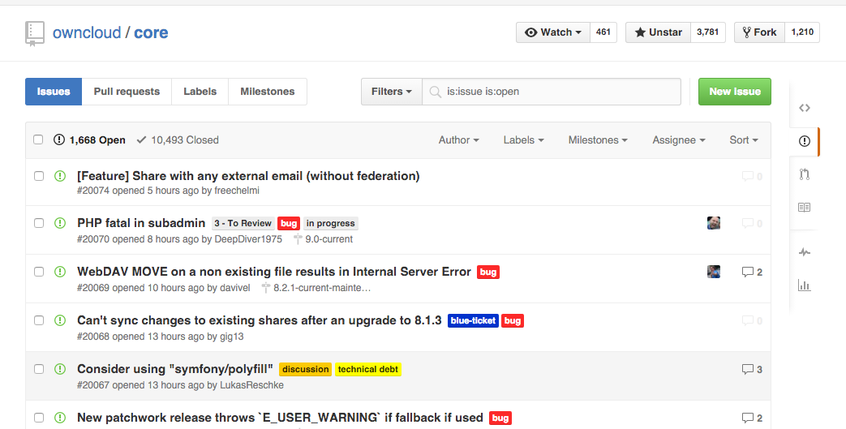
Beispiele
Notes:
Aside from having many users, ownCloud also has a large development community.
In part that is because ownCloud is more than sync and share. Our apps bring functionality like calendar and contacts, mail, notes and much more to ownCloud.

Slide 13
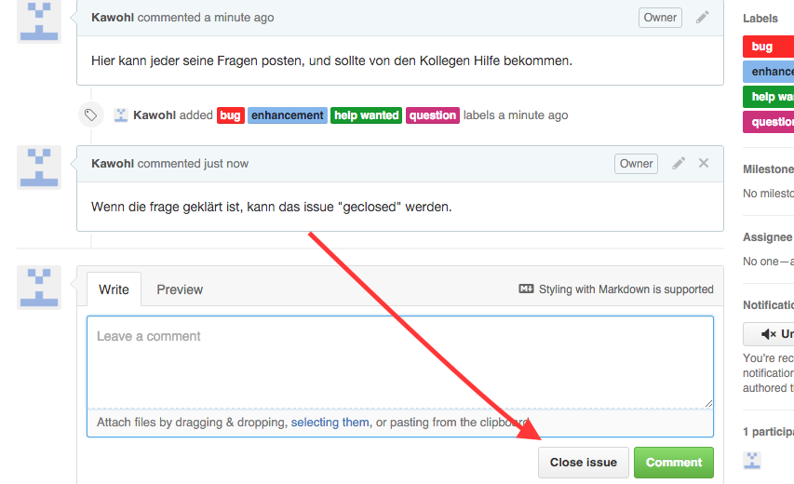
Beispiele
Notes:
Aside from having many users, ownCloud also has a large development community.
In part that is because ownCloud is more than sync and share. Our apps bring functionality like calendar and contacts, mail, notes and much more to ownCloud.

Slide 14
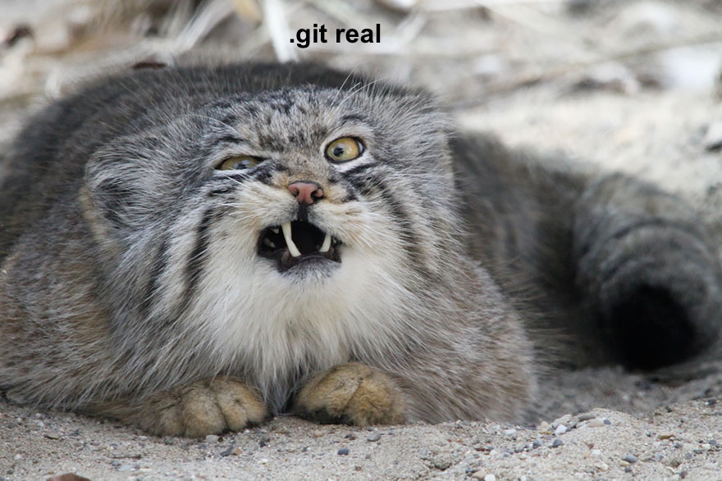
Cat Tax
Notes:
Aside from having many users, ownCloud also has a large development community.
In part that is because ownCloud is more than sync and share. Our apps bring functionality like calendar and contacts, mail, notes and much more to ownCloud.

Slide 15
.git Fragen?

Slide 16
Quellen und nützliches
https://en.wikipedia.org/wiki/Git_(software)
https://rogerdudler.github.io/git-guide/index.de.html
Github.com
Gitlab.com
https://www.codeschool.com/courses/try-git
Notes:
Aside from having many users, ownCloud also has a large development community.
In part that is because ownCloud is more than sync and share. Our apps bring functionality like calendar and contacts, mail, notes and much more to ownCloud.

